Slide 1

WIPRO NGA Program – Datacenter Batch
Capstone Project Presentation – 06 April 2024
Project Title Here - Capstone Project
Presented by - Biswajit Mishra
www.rpsconsulting.in

Slide 2

Project -2
Objective: Install the CentOS 7 server (after installation GUI must be present). Attach 3 disks of 5GB each & create 2 LVMs from these disks of 7GB (/lvm1) and 8GB (/lvm2) with XFS and EXT4 file systems respectively and verify. Install the following RPM packages using the package manager of your choice using a single command.
VSFTPD
PHP
System-Config-Kickstart
finger.
Start “YES” process and use the TOP command to kill this process.
CONTENT
Sl No | Functions
1 | Installing CentOS 7 using the text-mode installation
2 | Change settings and start the installation
3 | Change cli to gui using init 5
4 | Change the ip and host name using nmtui command
5 | Creation of LVM – Add 3 disk , creation physical disk, physical volume, volume group and 2 logical volume with xfs and ext4 file system. And verify it
6 | Start yes process and kill it using top command
7 | Installing the packets using yum in single command
2024 - RPS Consulting all rights reserved

Slide 3
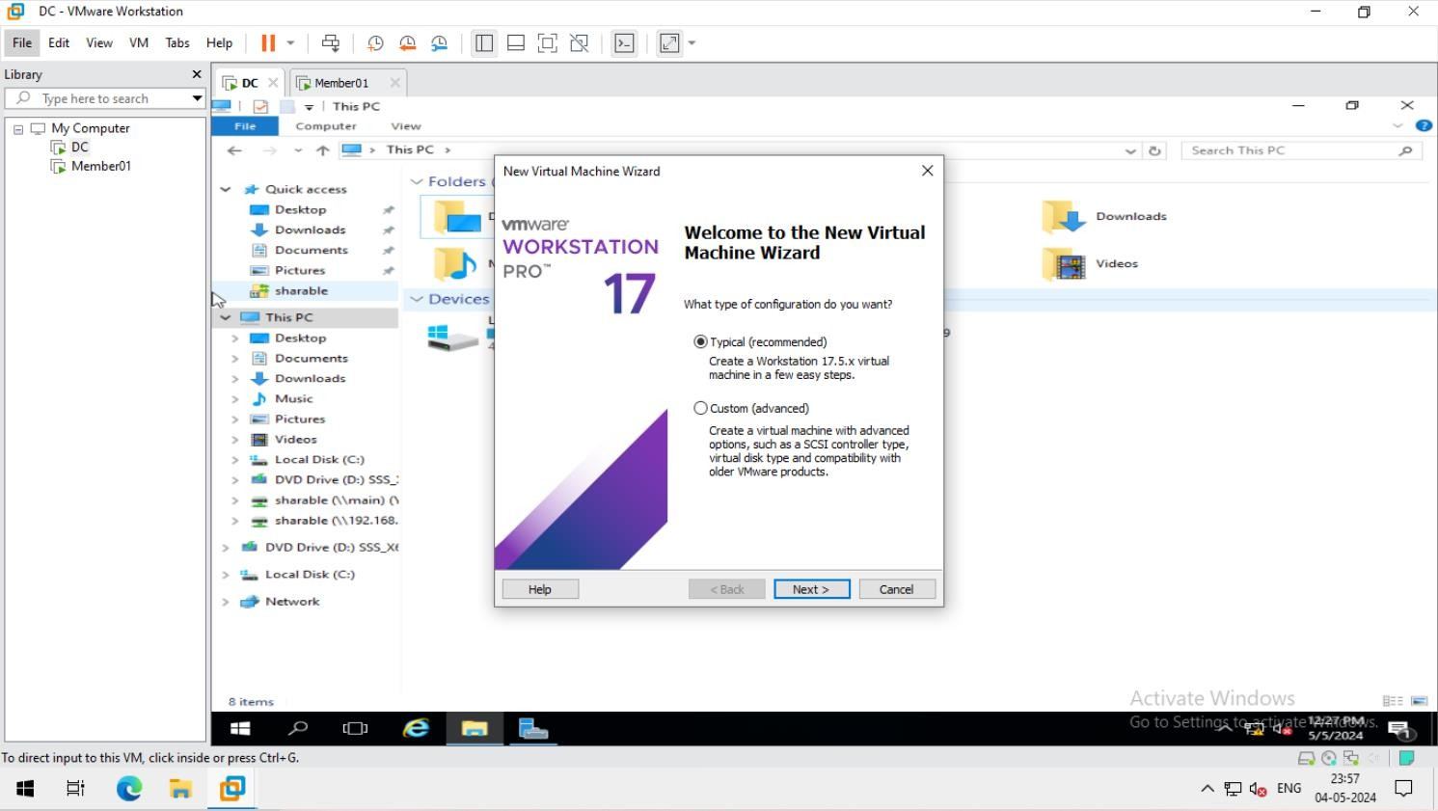
1. creating a new CentOS 7 using text-mode installation.
2024 - RPS Consulting all rights reserved

Slide 4
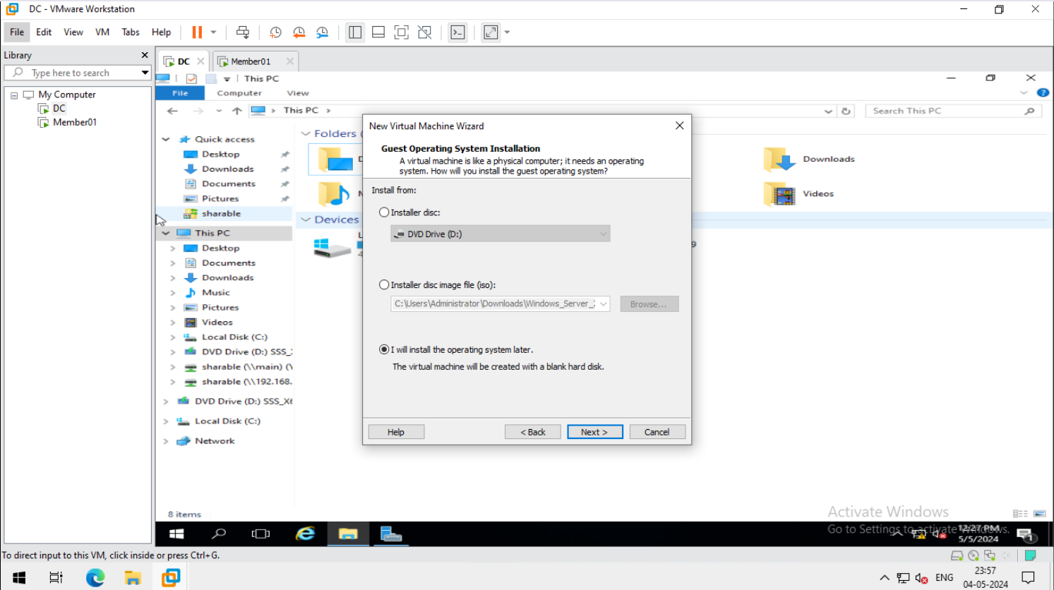
2024 - RPS Consulting all rights reserved

Slide 5
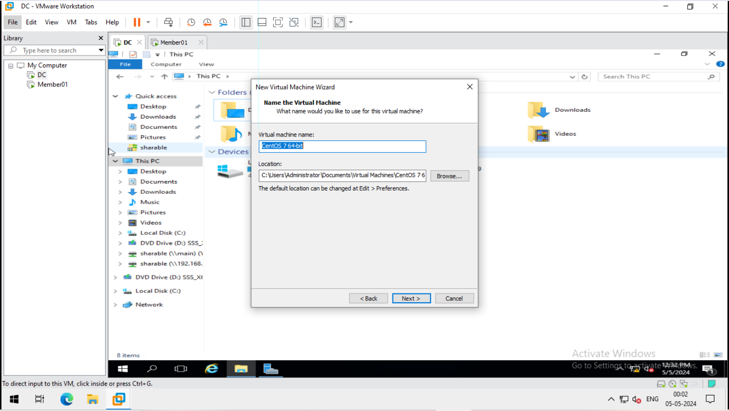
2024 - RPS Consulting all rights reserved

Slide 6
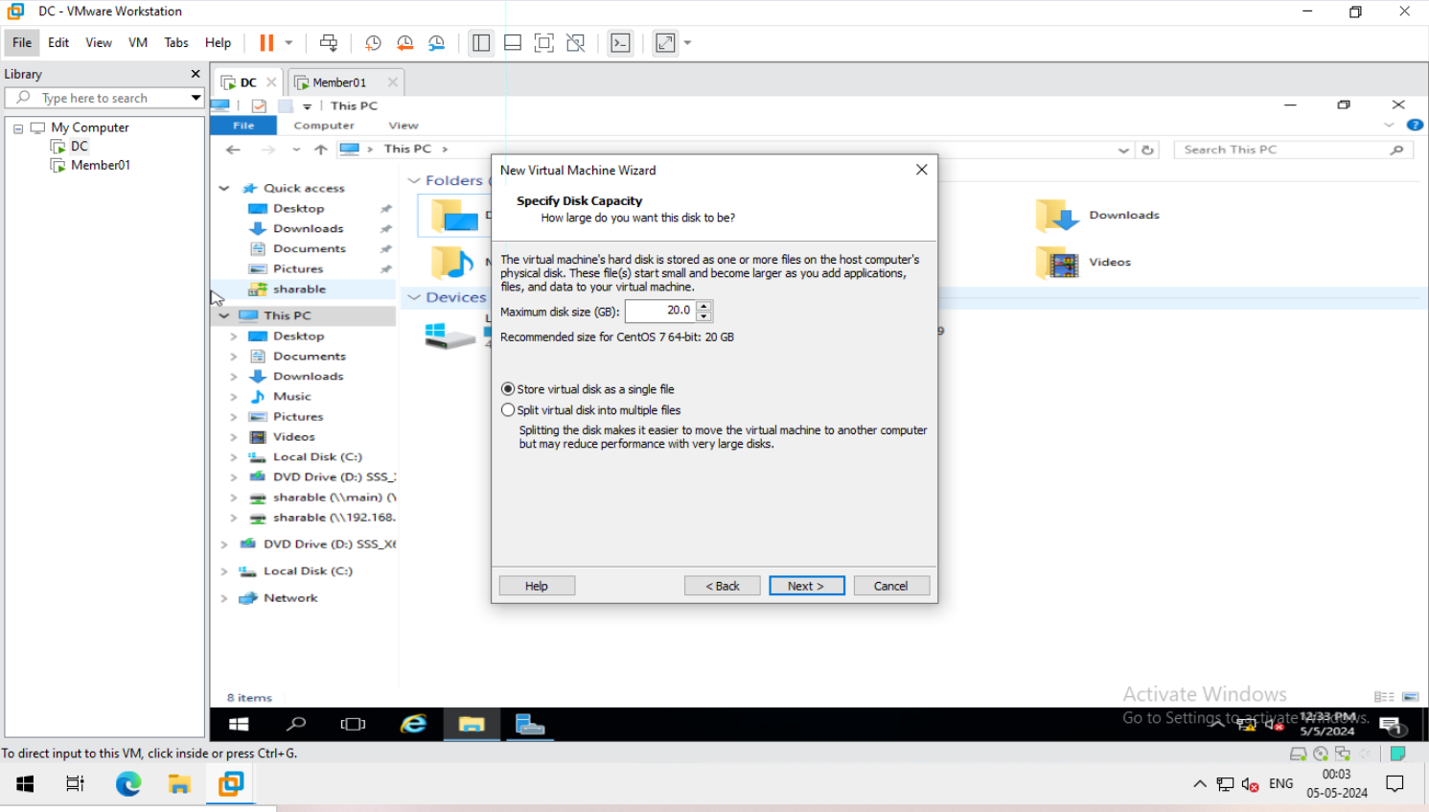
2024 - RPS Consulting all rights reserved

Slide 7
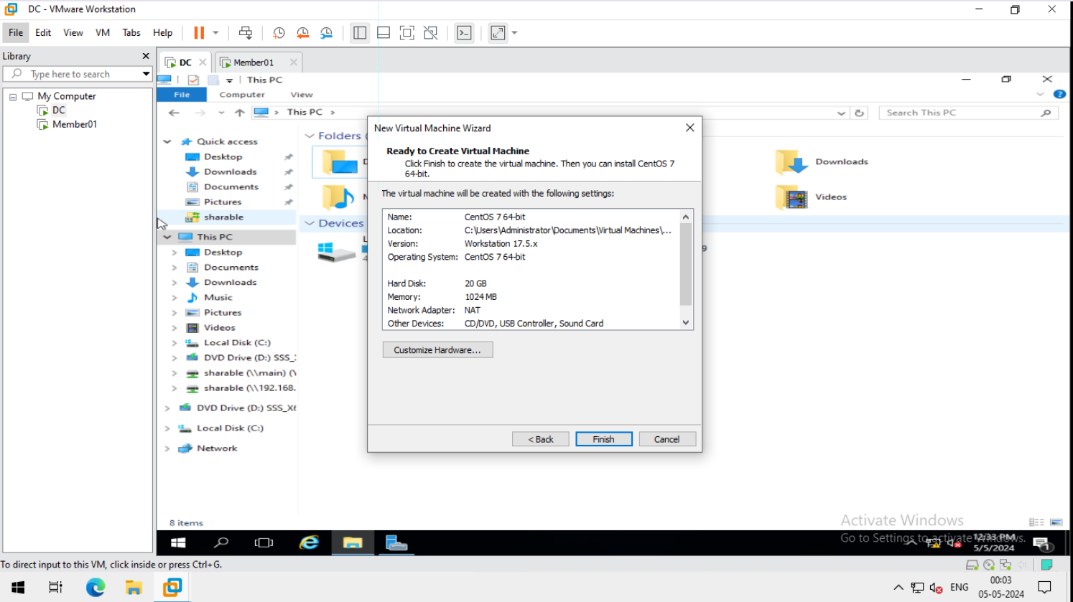
2024 - RPS Consulting all rights reserved

Slide 8
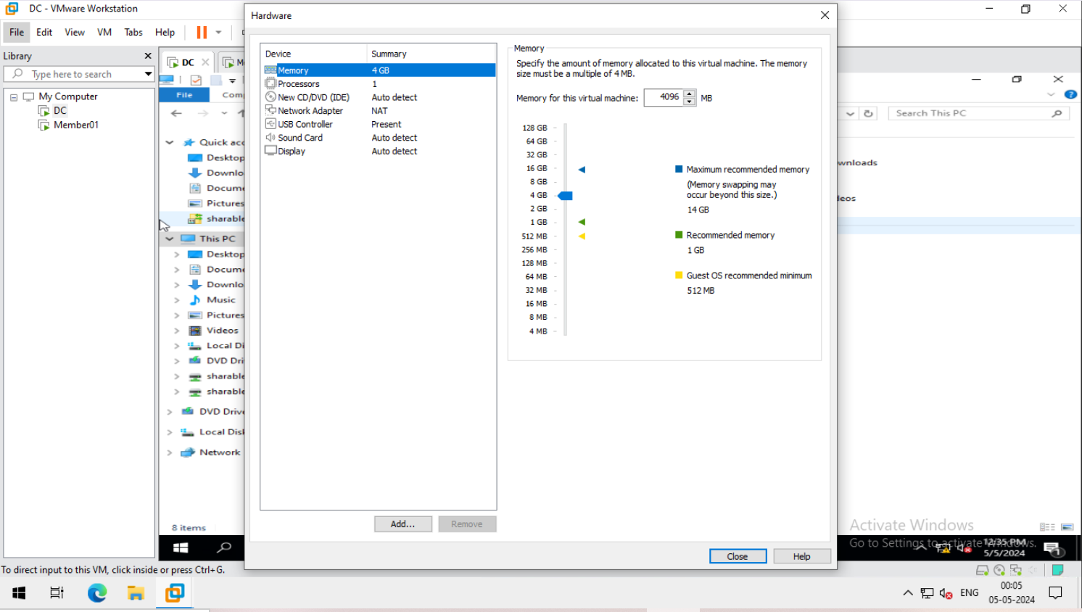
2024 - RPS Consulting all rights reserved

Slide 9
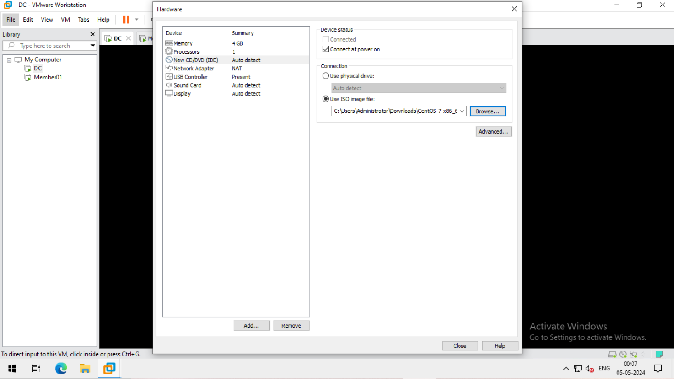
2024 - RPS Consulting all rights reserved

Slide 10
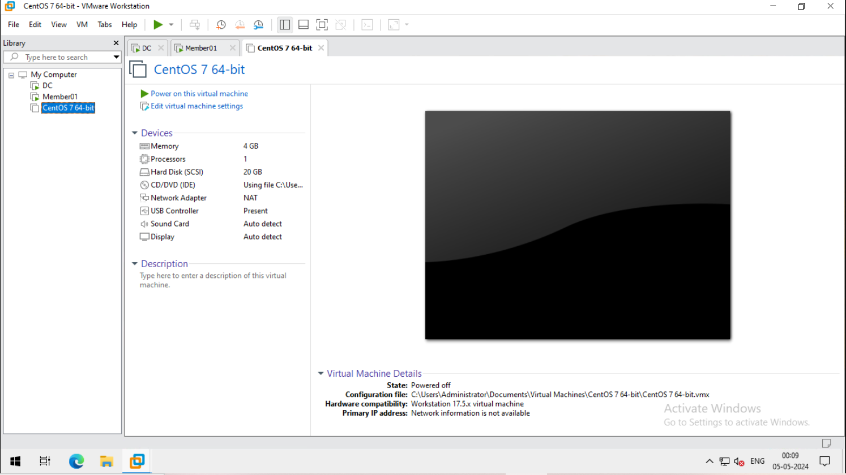
2024 - RPS Consulting all rights reserved

Slide 11
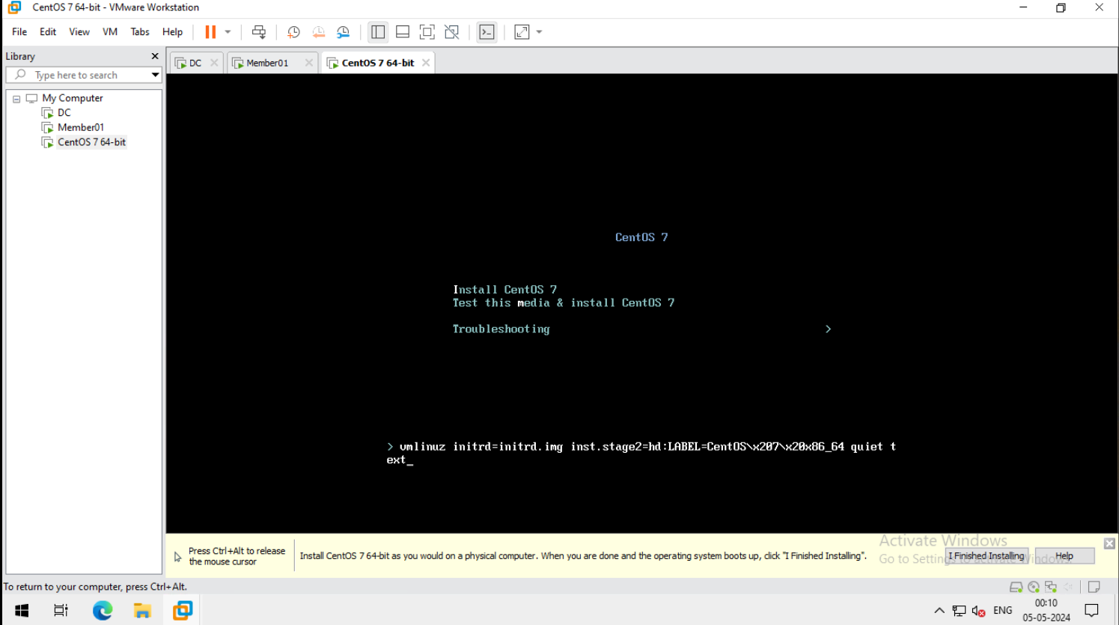
2024 - RPS Consulting all rights reserved

Slide 12
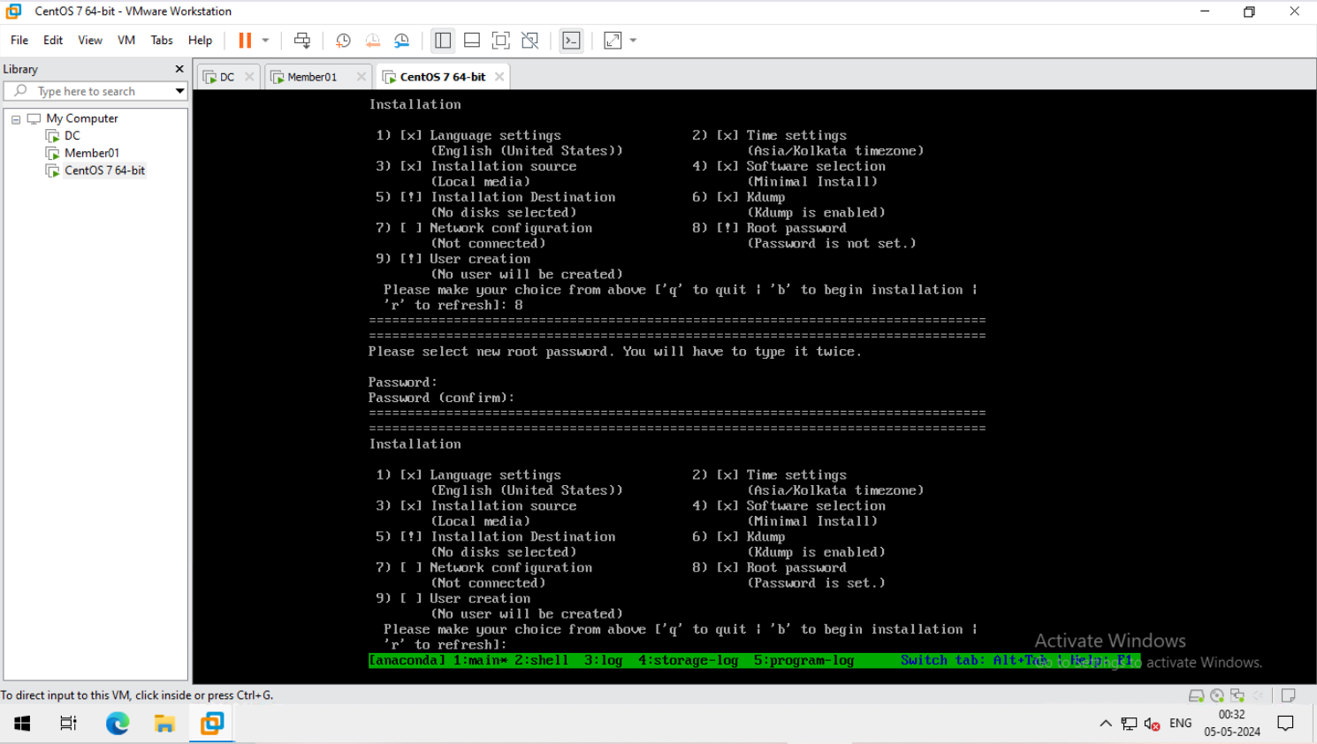
2. Change settings and start the installation
2024 - RPS Consulting all rights reserved

Slide 13
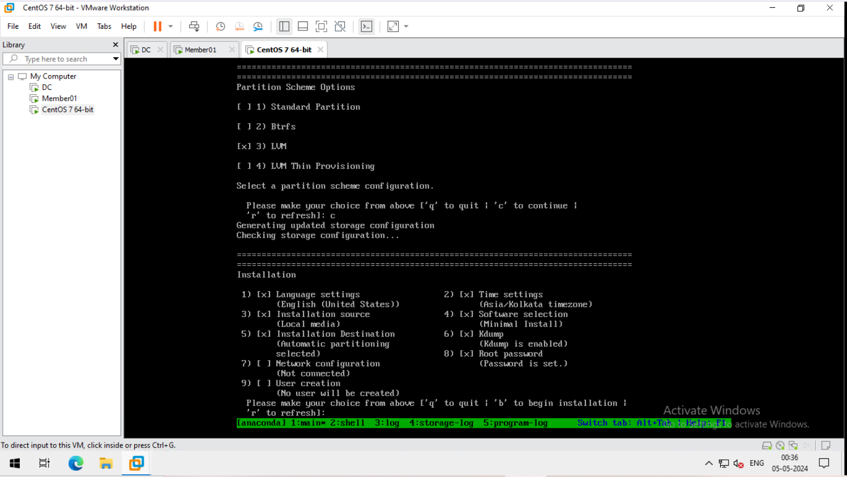
2024 - RPS Consulting all rights reserved

Slide 14
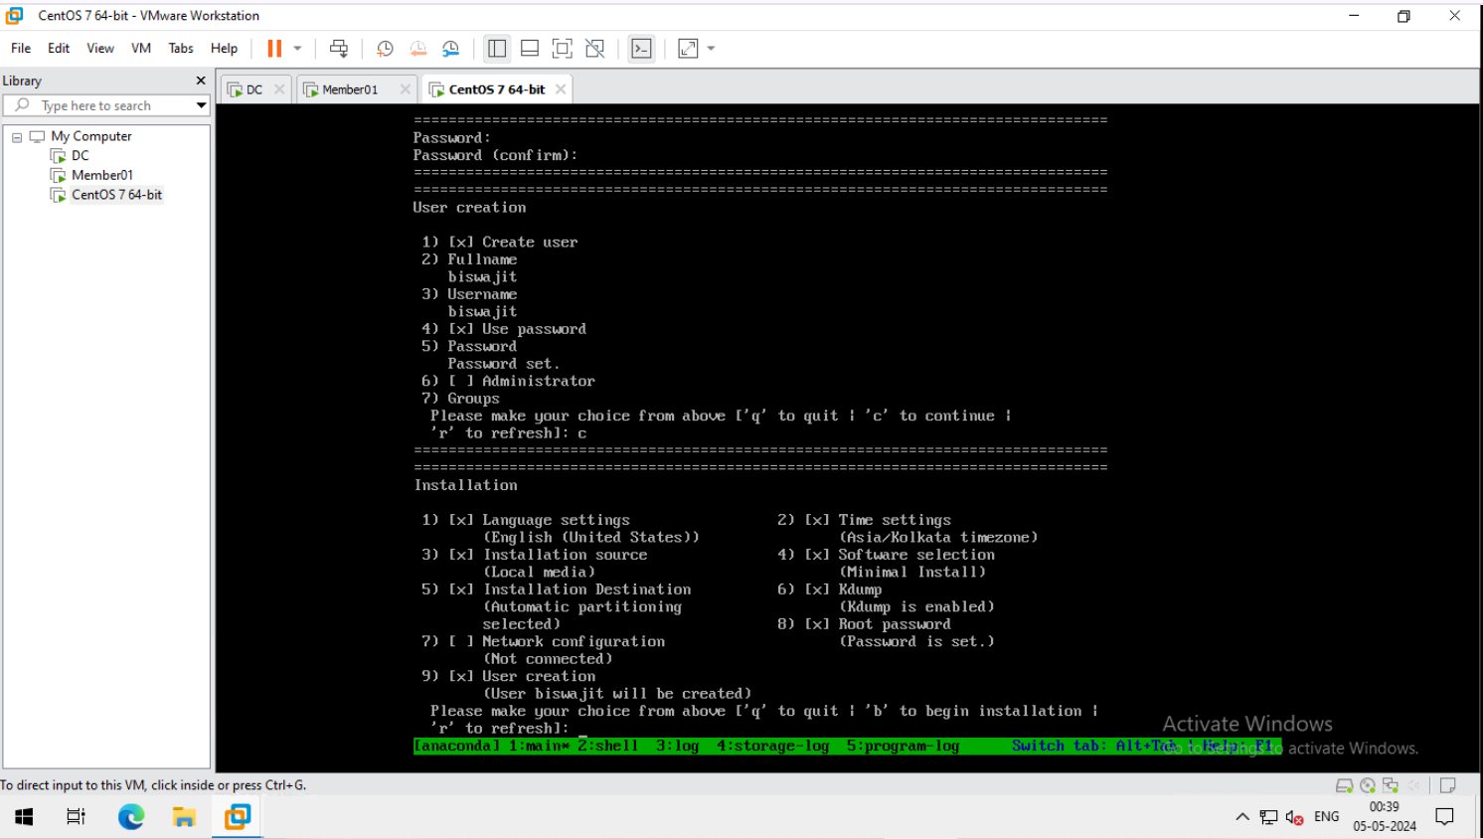
2024 - RPS Consulting all rights reserved

Slide 15
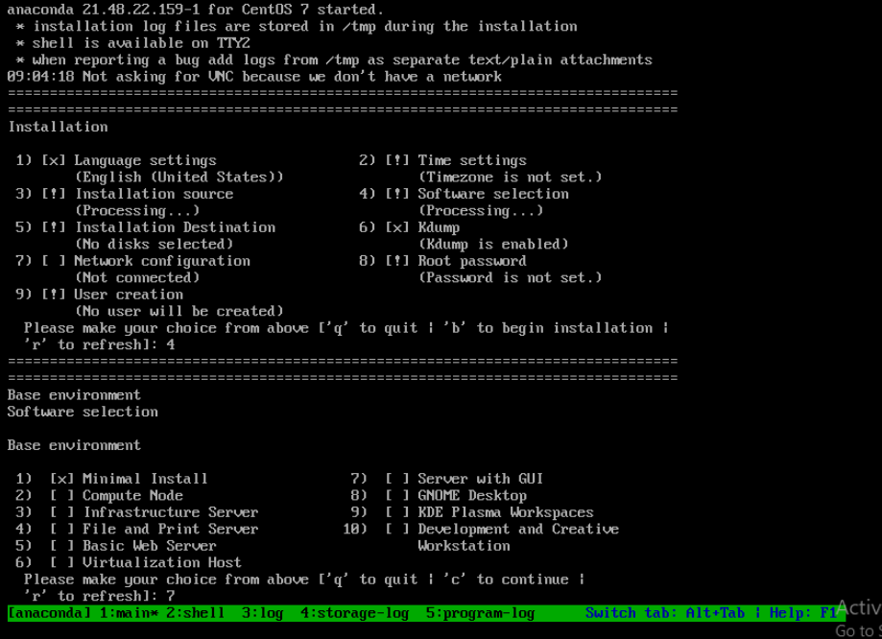
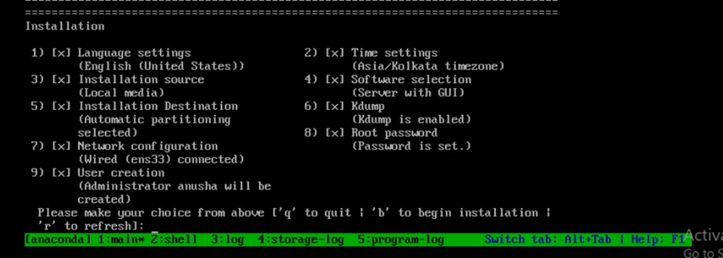
2024 - RPS Consulting all rights reserved

Slide 16
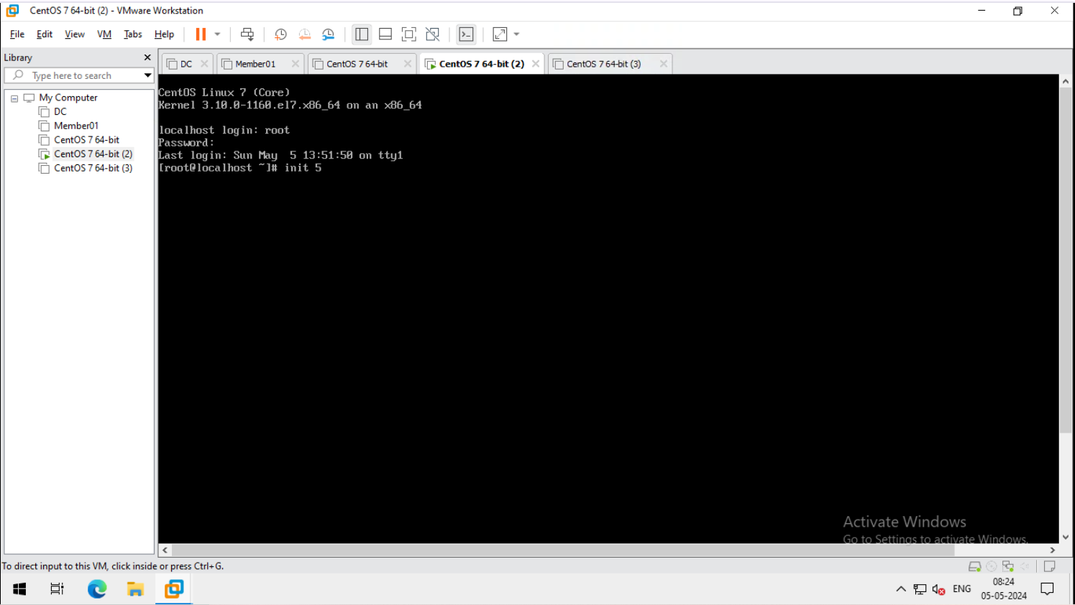
3. Log in into gui
2024 - RPS Consulting all rights reserved

Slide 17
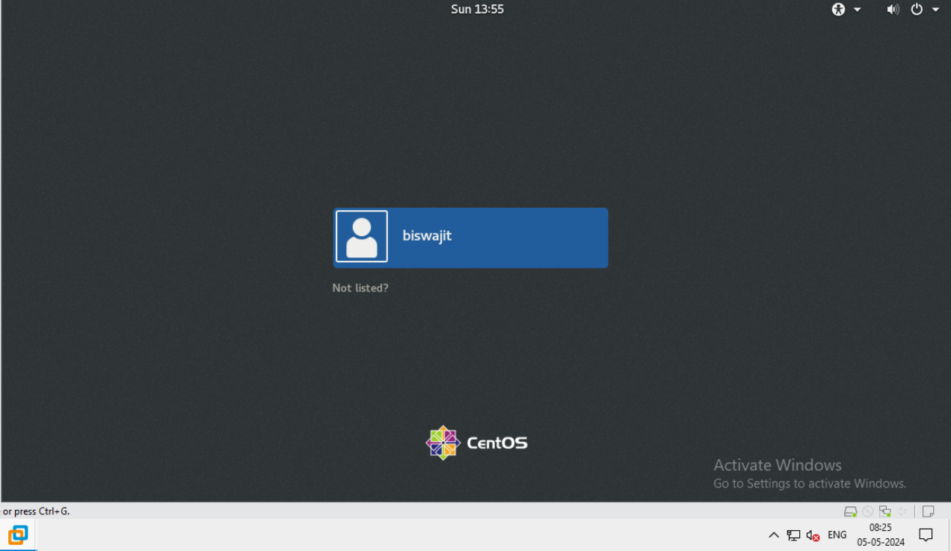
2024 - RPS Consulting all rights reserved

Slide 18
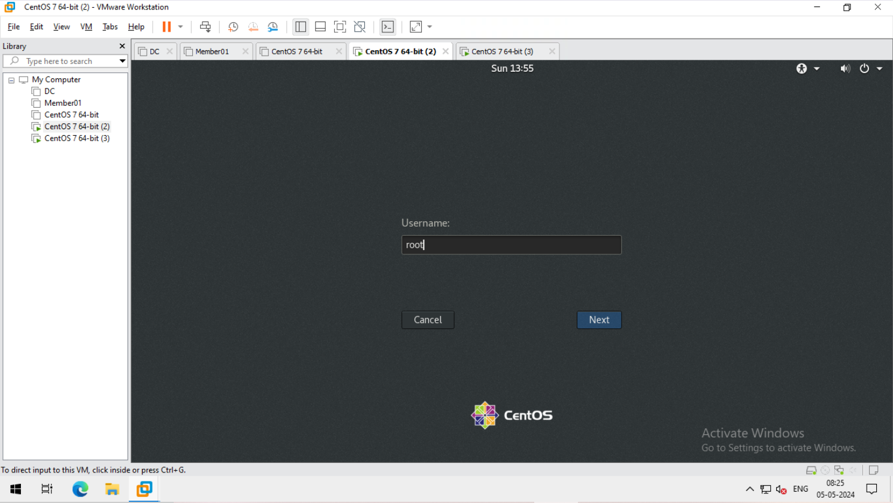
Slide Title
Slide details here
2024 - RPS Consulting all rights reserved

Slide 19
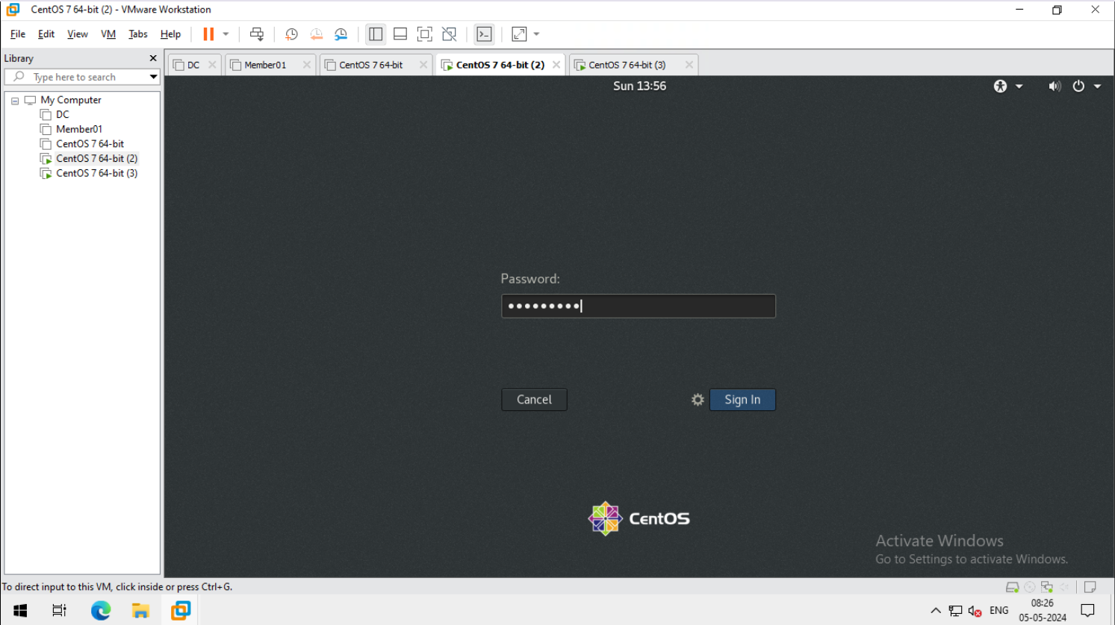
Slide Title
Slide details here
2024 - RPS Consulting all rights reserved

Slide 20
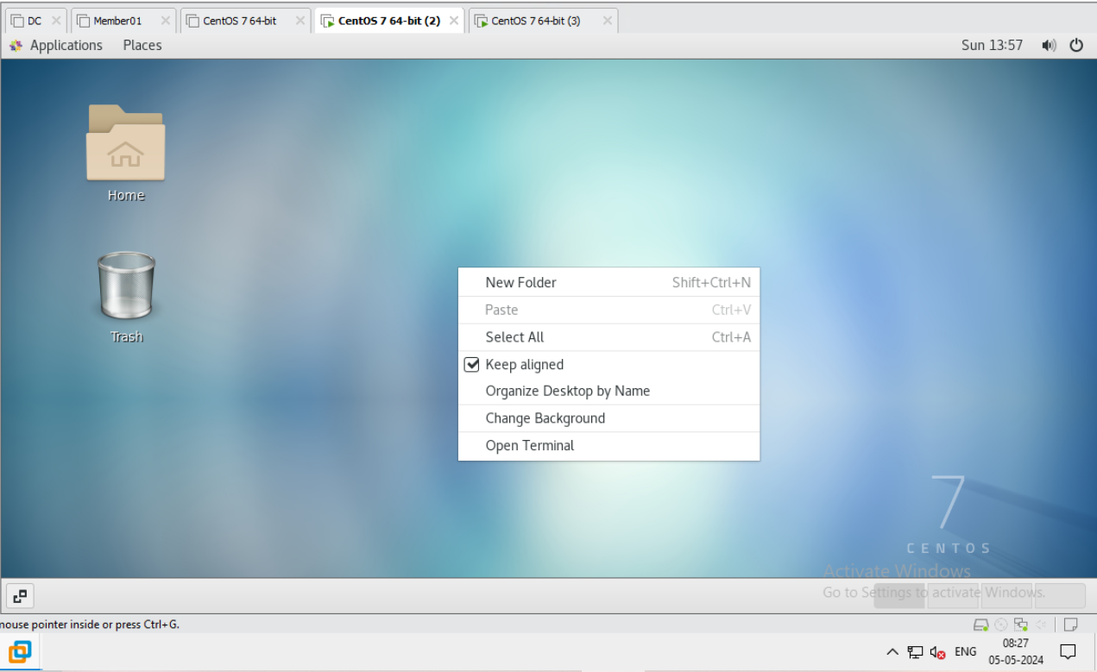
Slide Title
Slide details here
2024 - RPS Consulting all rights reserved

Slide 21
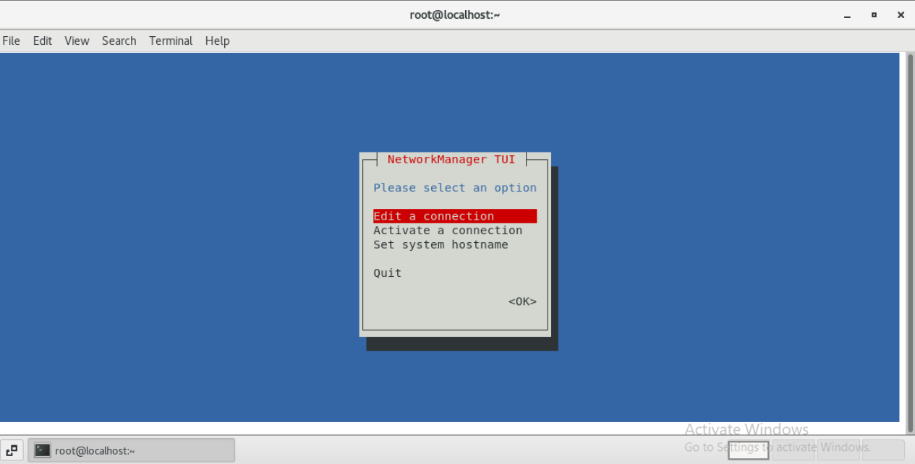
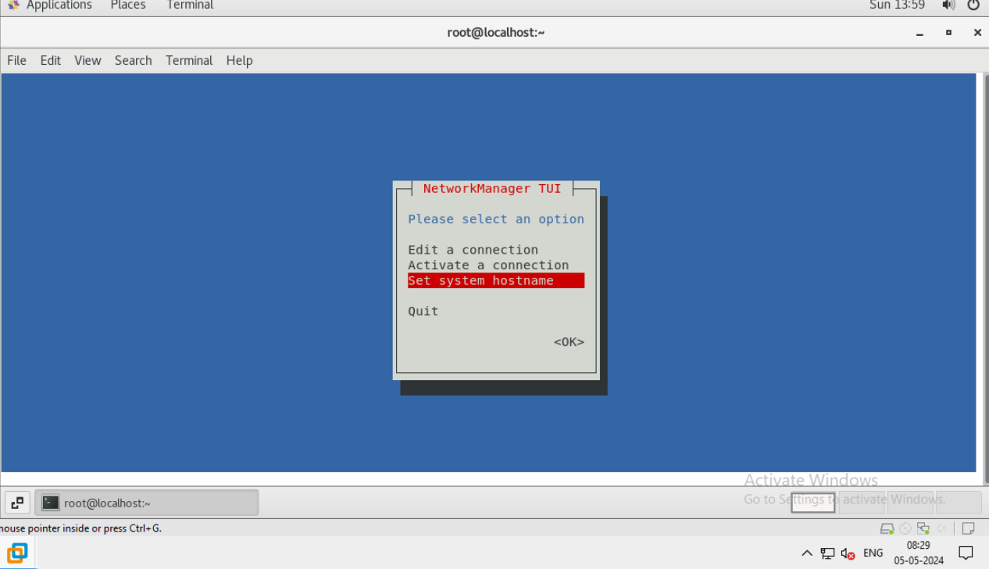
4. Change the ip and host name using nmtui command
2024 - RPS Consulting all rights reserved

Slide 22
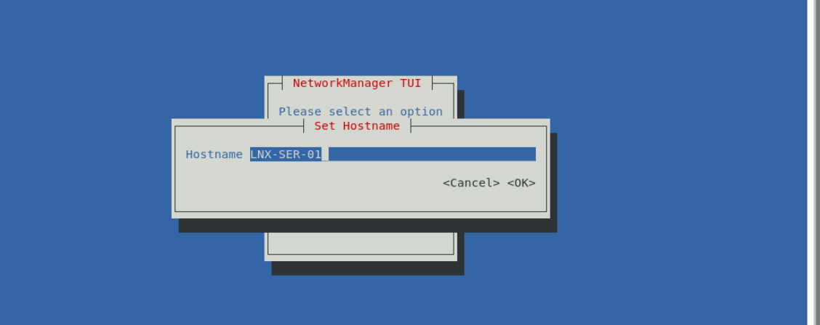
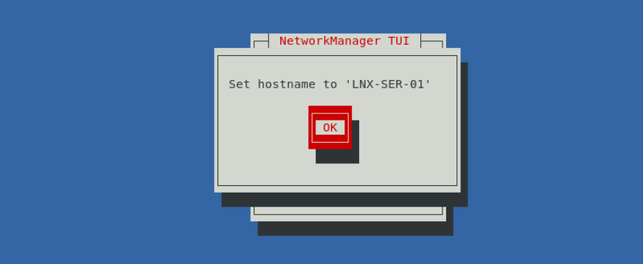
Slide details here
2024 - RPS Consulting all rights reserved

Slide 23
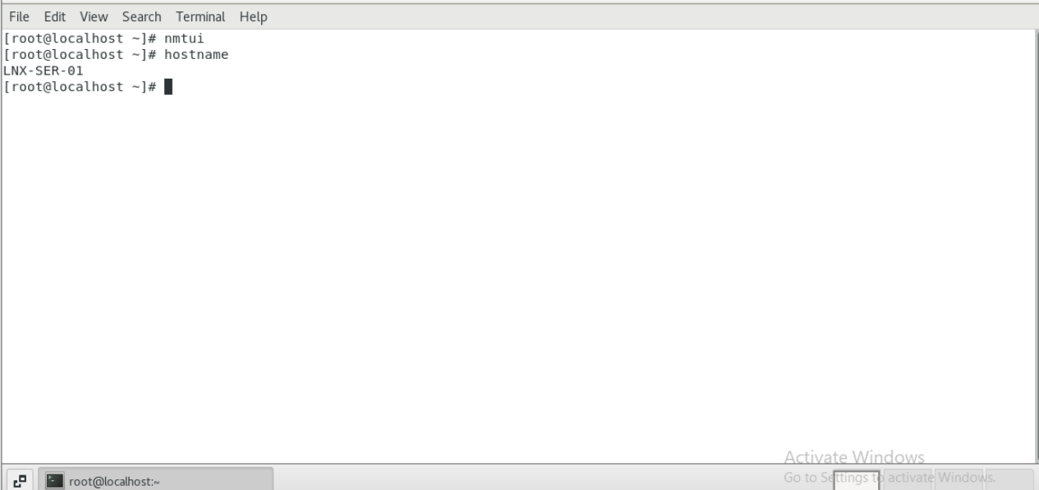
Slide Title
Slide details here
2024 - RPS Consulting all rights reserved

Slide 24

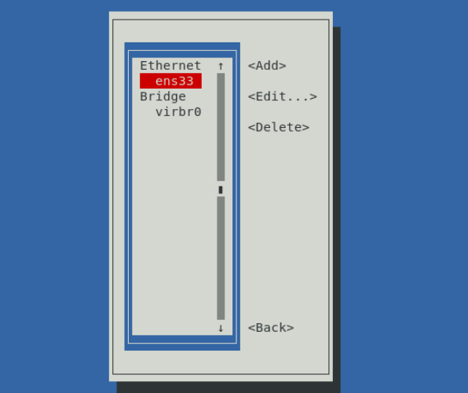
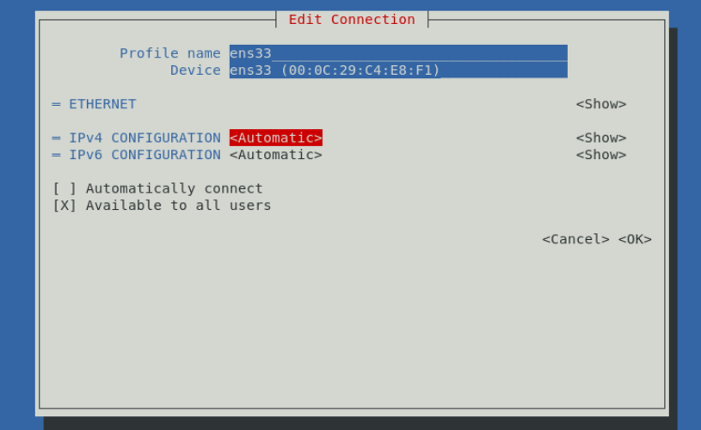
Slide details here
2024 - RPS Consulting all rights reserved

Slide 25
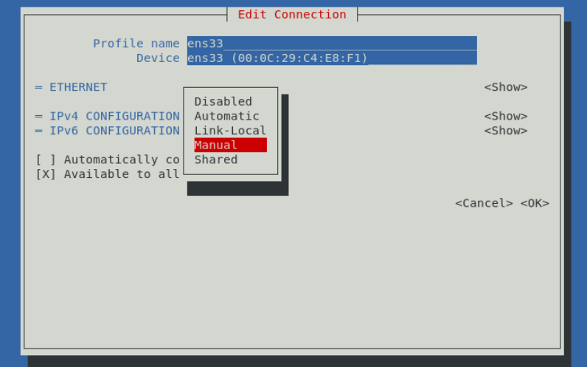
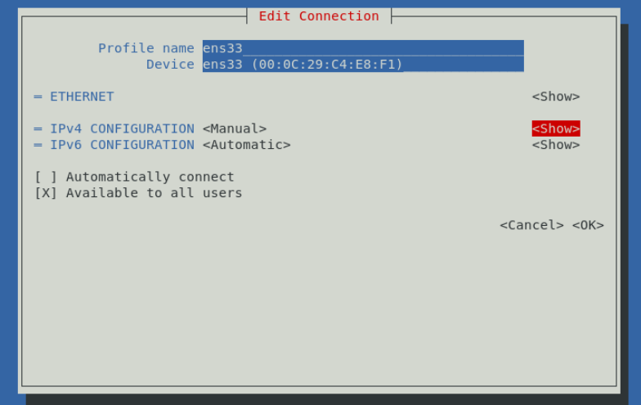
Slide details here
2024 - RPS Consulting all rights reserved

Slide 26
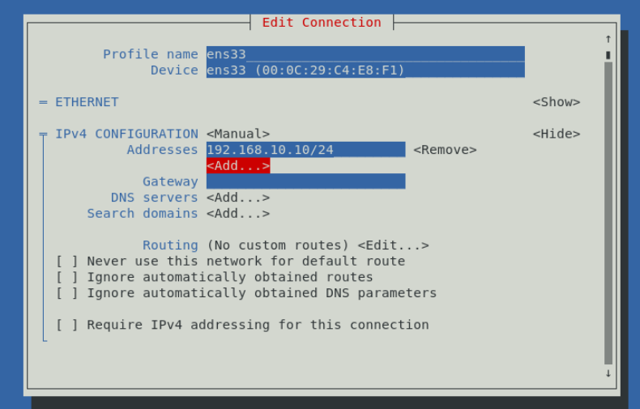
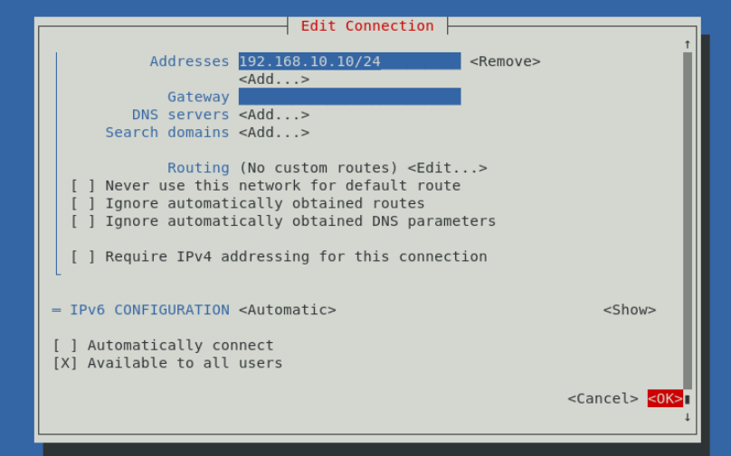
Slide details here
2024 - RPS Consulting all rights reserved

Slide 27
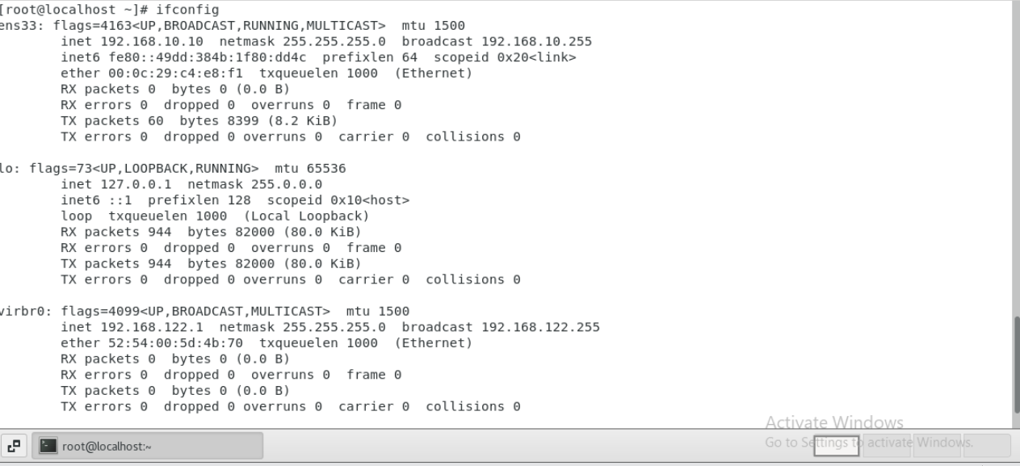
Slide Title
Slide details here
2024 - RPS Consulting all rights reserved

Slide 28
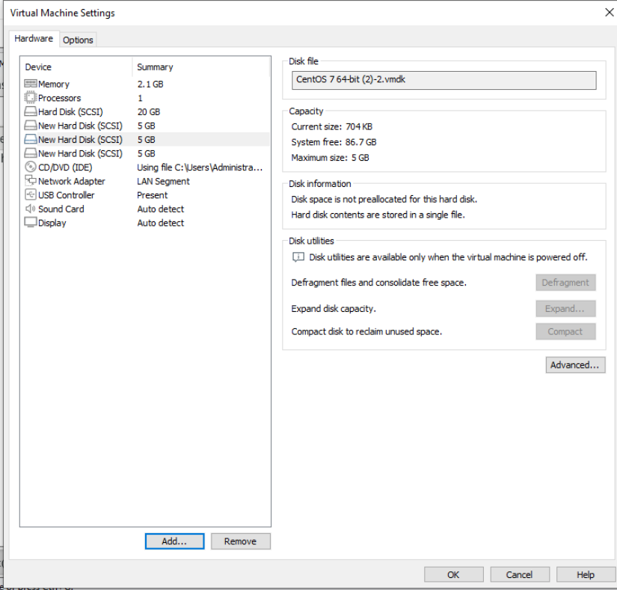
5. Creation of LVM
2024 - RPS Consulting all rights reserved

Slide 29
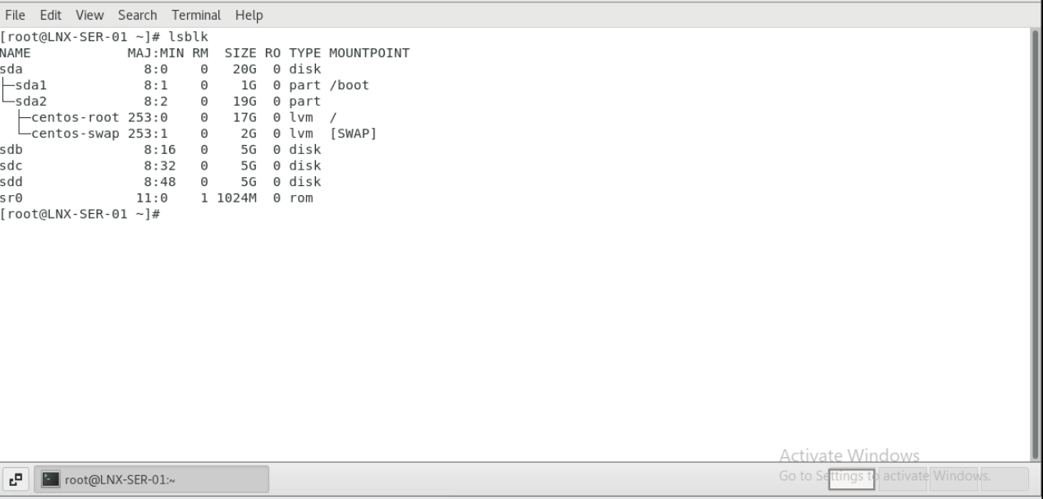
2024 - RPS Consulting all rights reserved

Slide 30
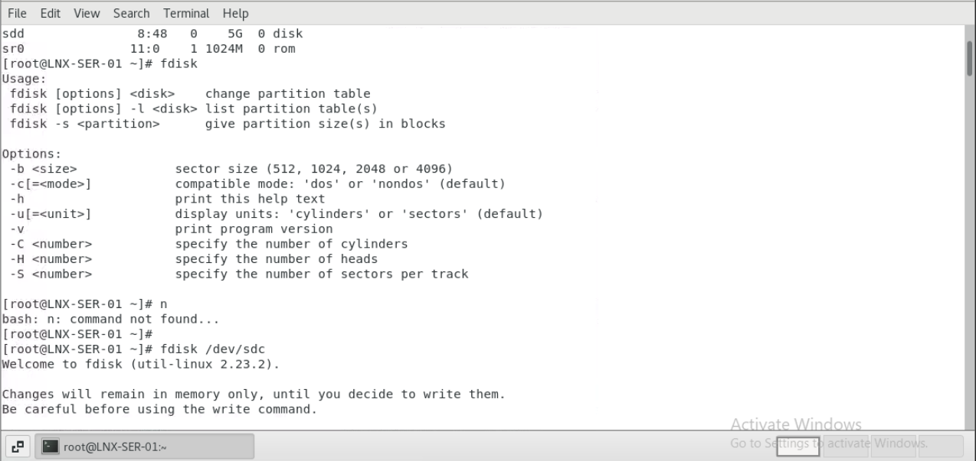
Slide Title
Slide details here
2024 - RPS Consulting all rights reserved

Slide 31
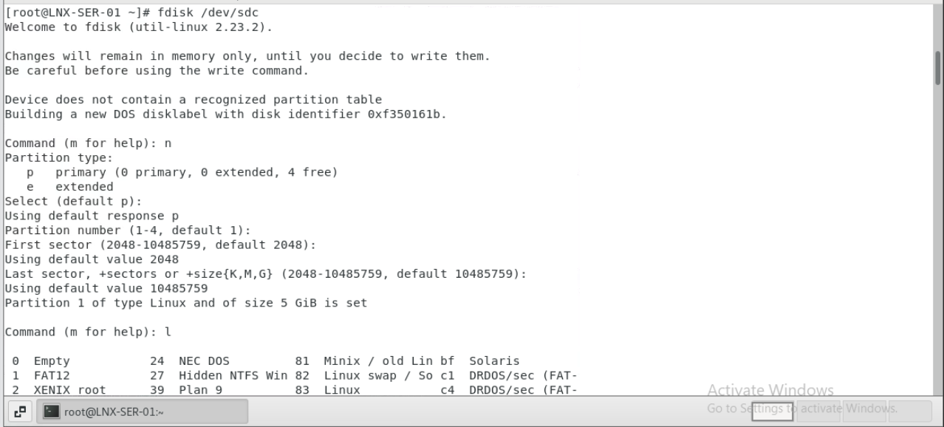
Slide Title
Slide details here
2024 - RPS Consulting all rights reserved

Slide 32
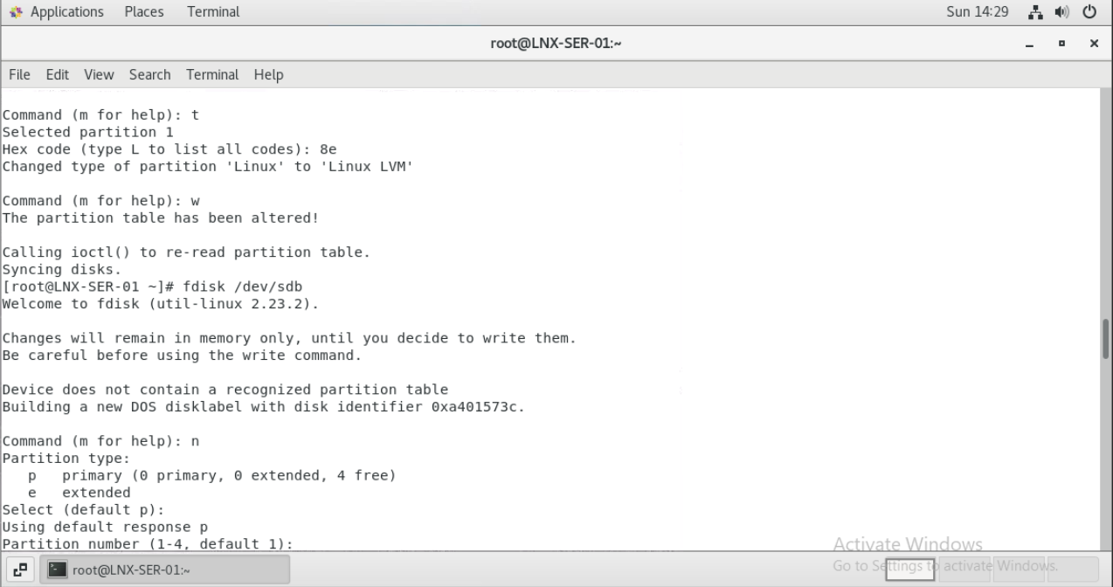
Slide Title
Slide details here
2024 - RPS Consulting all rights reserved

Slide 33
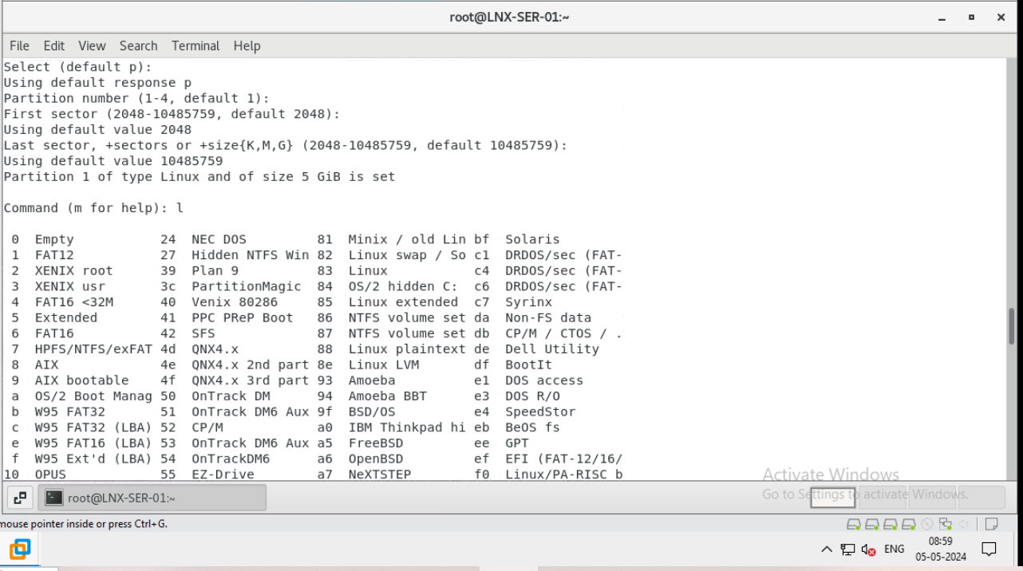
Slide Title
Slide details here
2024 - RPS Consulting all rights reserved

Slide 34
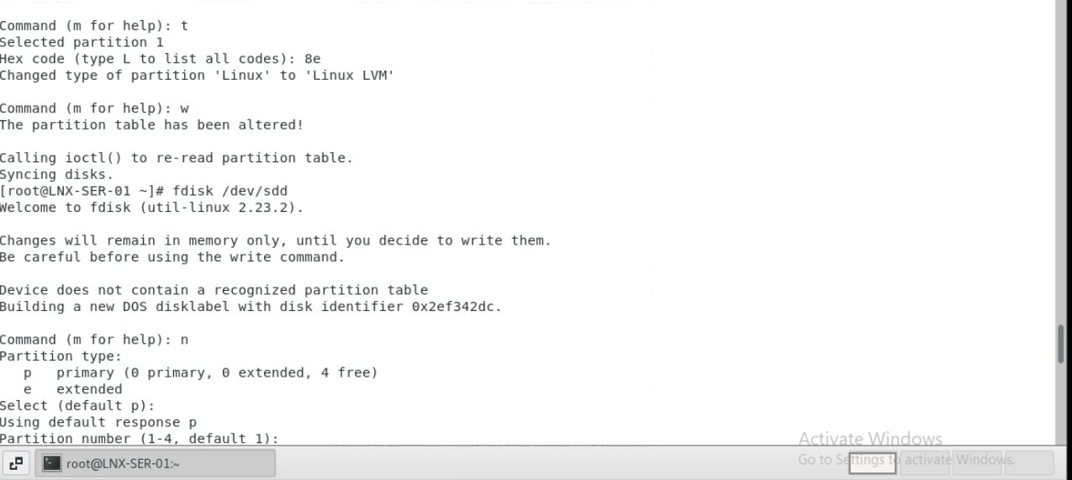
Slide Title
Slide details here
2024 - RPS Consulting all rights reserved

Slide 35
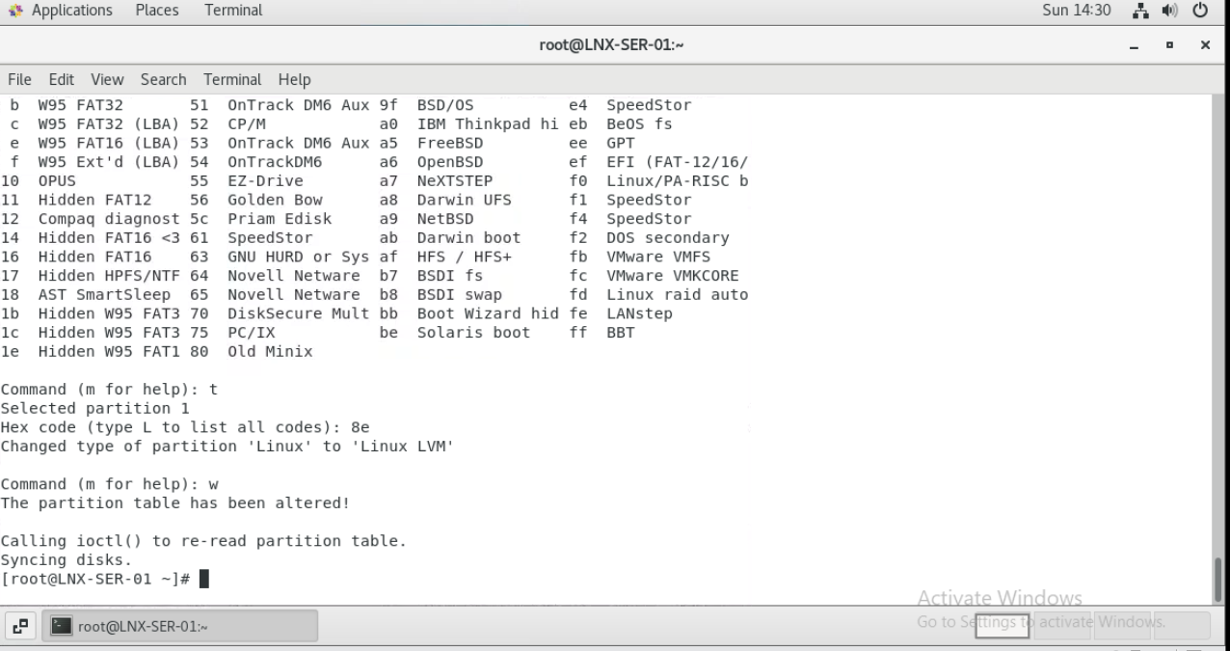
Slide Title
Slide details here
2024 - RPS Consulting all rights reserved

Slide 36
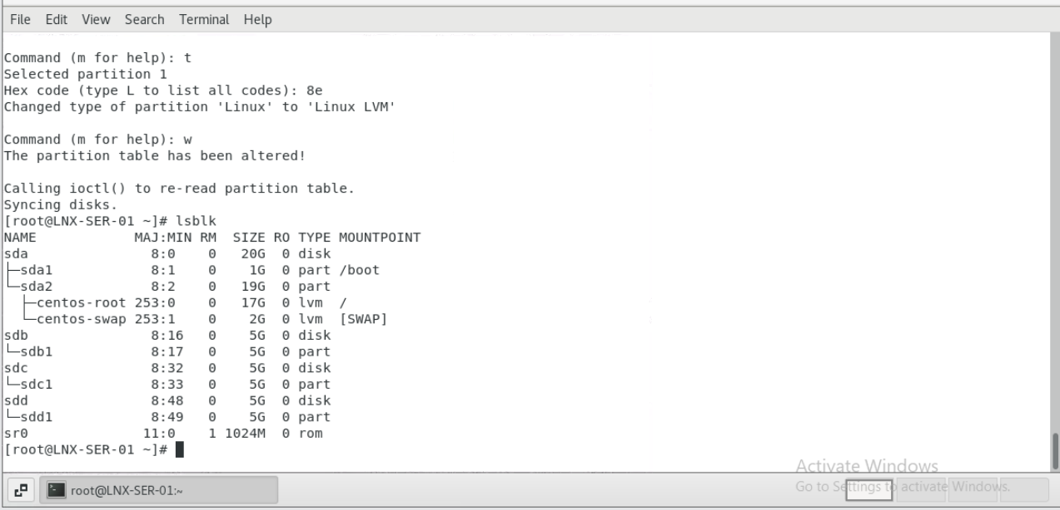
Slide Title
Slide details here
2024 - RPS Consulting all rights reserved

Slide 37
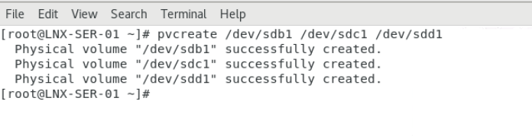
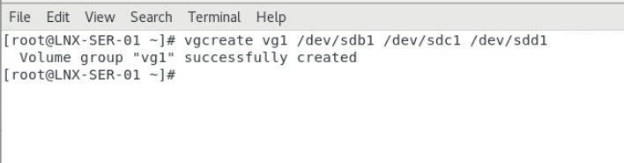
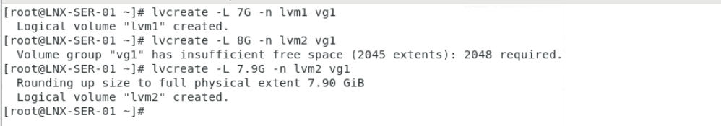
Slide Title
Slide details here
2024 - RPS Consulting all rights reserved

Slide 38
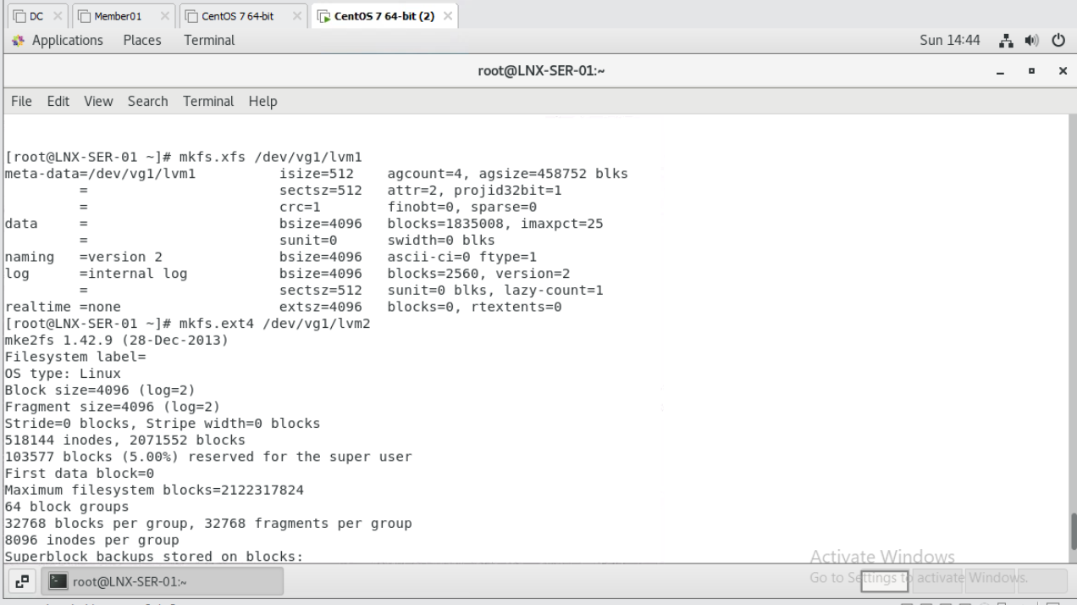
Slide details here
2024 - RPS Consulting all rights reserved

Slide 39
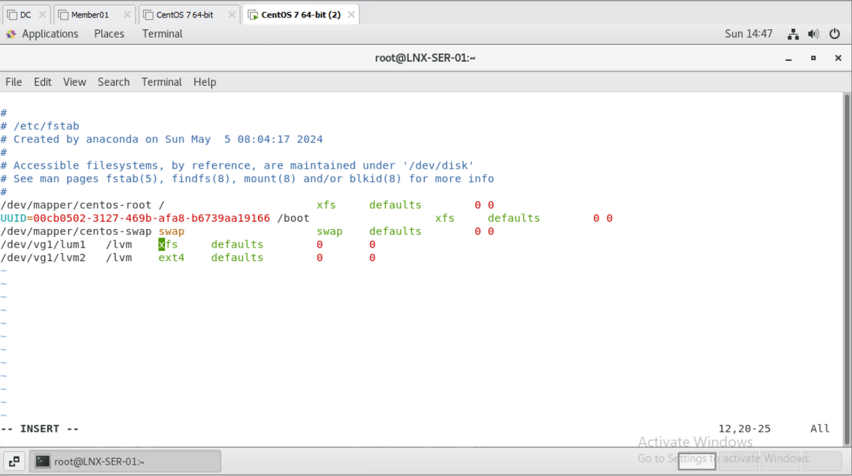
2024 - RPS Consulting all rights reserved

Slide 40
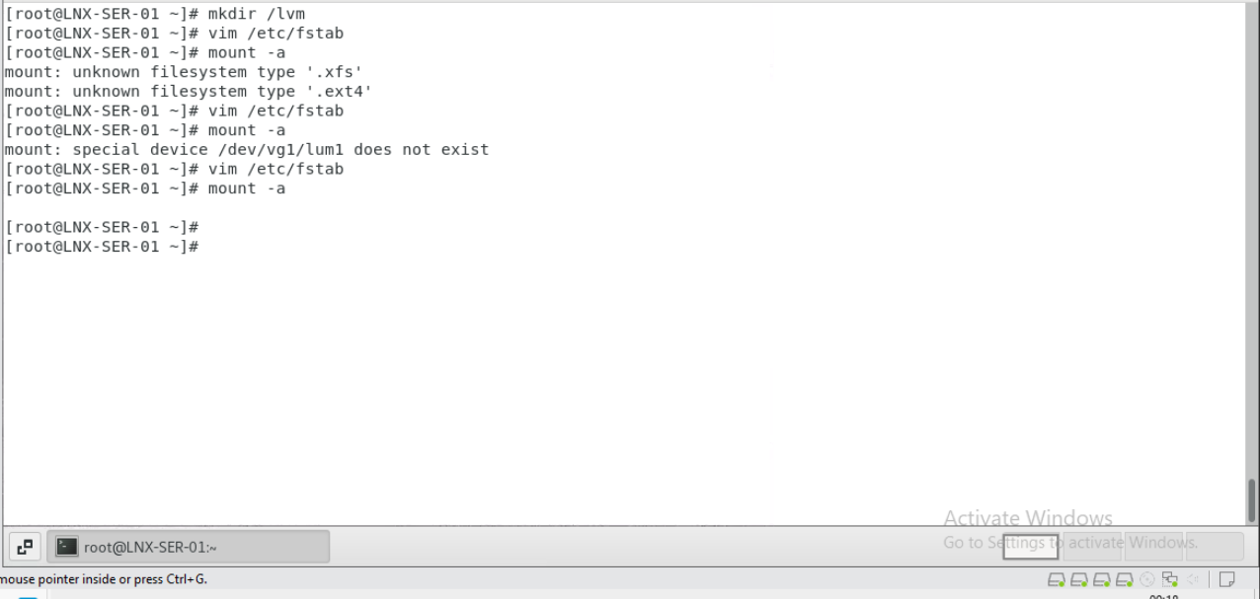
Slide Title
Slide details here
2024 - RPS Consulting all rights reserved

Slide 41
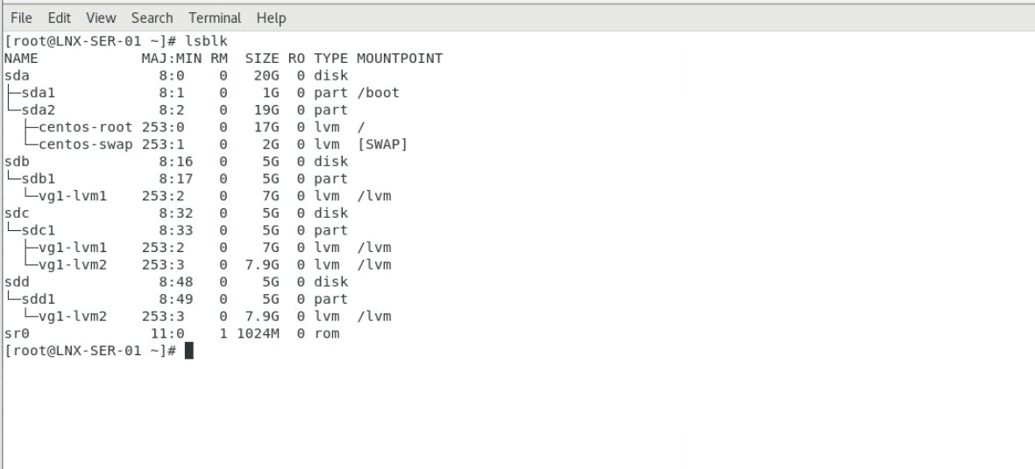
Slide Title
Slide details here
2024 - RPS Consulting all rights reserved

Slide 42
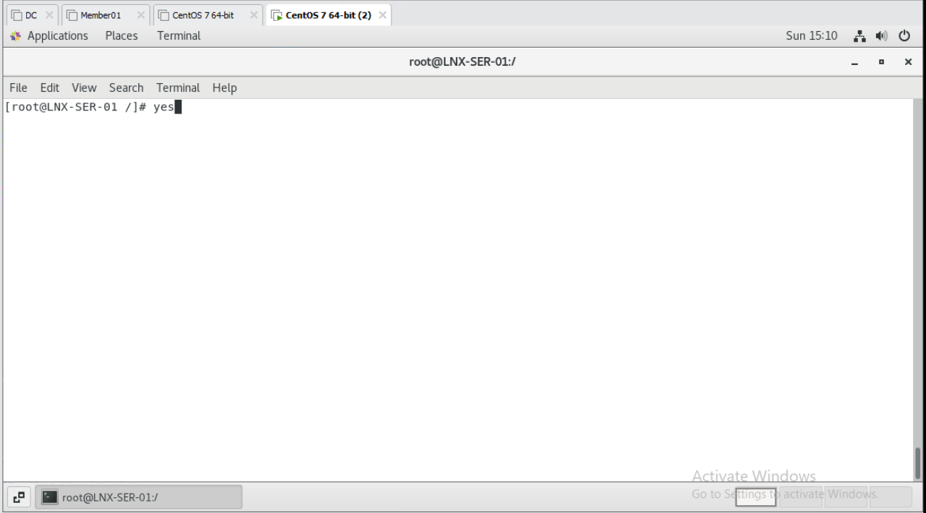
6. Start yes process and kill it using top command
2024 - RPS Consulting all rights reserved

Slide 43
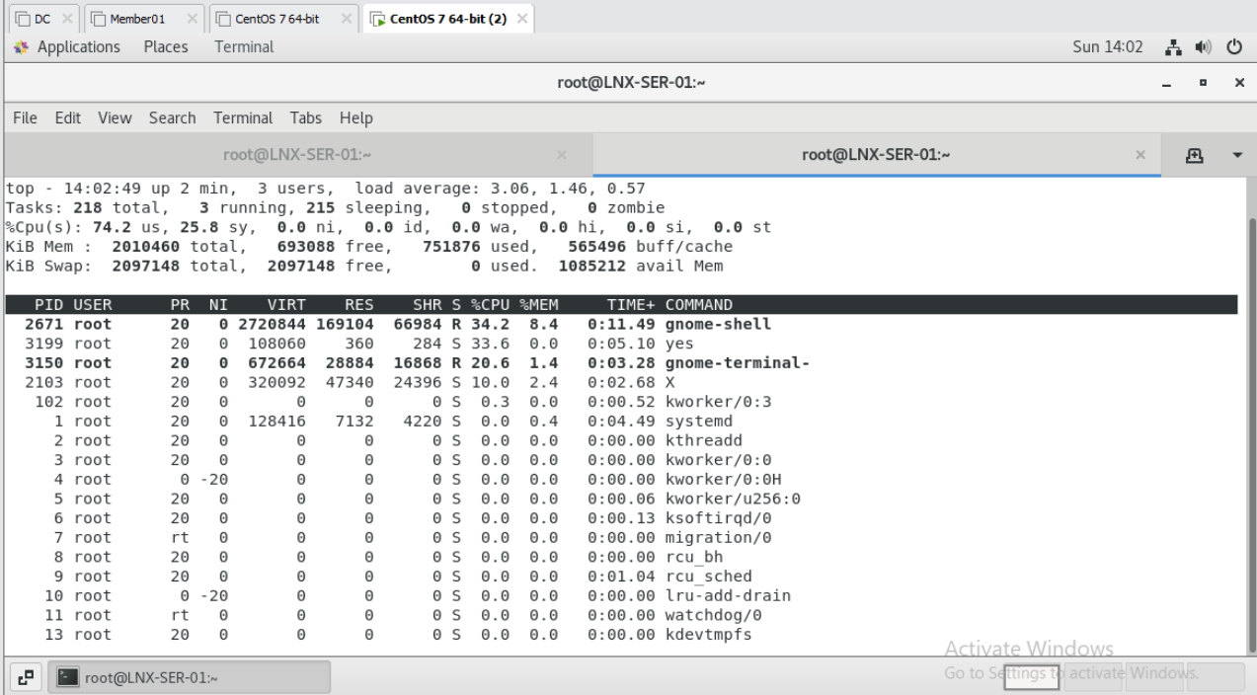
2024 - RPS Consulting all rights reserved

Slide 44
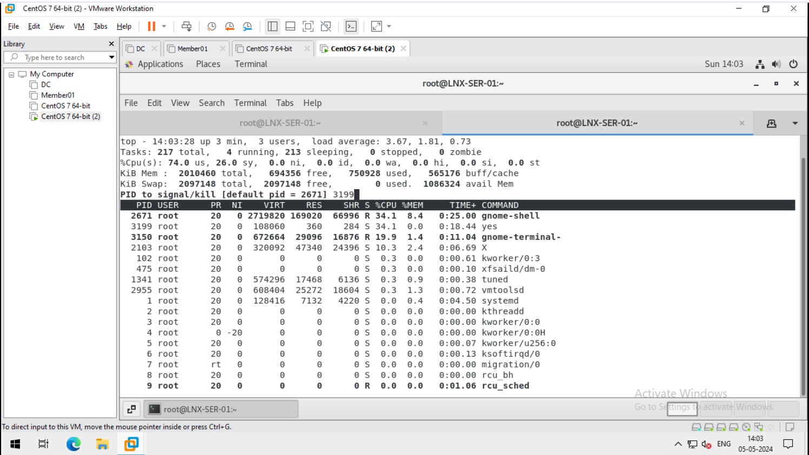
2024 - RPS Consulting all rights reserved

Slide 45

2024 - RPS Consulting all rights reserved

Slide 46

2024 - RPS Consulting all rights reserved

Slide 47


7.Installing the packets using yum in single command
2024 - RPS Consulting all rights reserved

Slide 48

Slide details here
2024 - RPS Consulting all rights reserved

Slide 49
PROJECT – 4
Use Cisco packet tracer and implement static routing and OSPF routing using 3 routers.
content
Sl no. | Function
1. Static routing using 3 routers | Add 3 pcs, 3 routers, 3 switches Assign IP to all pc Configure all 3 routers and assign IP to all ports Make Indirect connections between routers Ping one pc with another for test
2. OSPF using 3 routers | Add 2 pc, 3 router, 2 switches Assign IP to all pc Configure all 3 routers and assign IP to all ports make OSPF Configuretion. Ping one pc with another for test
2024 - RPS Consulting all rights reserved

Slide 50

1. Static routing using 3 routers
2024 - RPS Consulting all rights reserved

Slide 51

2024 - RPS Consulting all rights reserved

Slide 52

2024 - RPS Consulting all rights reserved

Slide 53

2024 - RPS Consulting all rights reserved

Slide 54

2024 - RPS Consulting all rights reserved

Slide 55

2024 - RPS Consulting all rights reserved

Slide 56

2024 - RPS Consulting all rights reserved

Slide 57

2024 - RPS Consulting all rights reserved

Slide 58

2024 - RPS Consulting all rights reserved

Slide 59

2024 - RPS Consulting all rights reserved

Slide 60

2024 - RPS Consulting all rights reserved

Slide 61

2024 - RPS Consulting all rights reserved

Slide 62

2024 - RPS Consulting all rights reserved

Slide 63

2024 - RPS Consulting all rights reserved

Slide 64

2024 - RPS Consulting all rights reserved

Slide 65

2024 - RPS Consulting all rights reserved

Slide 66

2024 - RPS Consulting all rights reserved

Slide 67

2024 - RPS Consulting all rights reserved

Slide 68

2024 - RPS Consulting all rights reserved

Slide 69

2. OSPF using 3 routers
2024 - RPS Consulting all rights reserved

Slide 70

2024 - RPS Consulting all rights reserved

Slide 71

2024 - RPS Consulting all rights reserved

Slide 72

2024 - RPS Consulting all rights reserved

Slide 73

2024 - RPS Consulting all rights reserved

Slide 74

2024 - RPS Consulting all rights reserved

Slide 75

2024 - RPS Consulting all rights reserved

Slide 76

2024 - RPS Consulting all rights reserved

Slide 77

2024 - RPS Consulting all rights reserved

Slide 78

2024 - RPS Consulting all rights reserved

Slide 79

2024 - RPS Consulting all rights reserved

Slide 80

2024 - RPS Consulting all rights reserved

Slide 81

2024 - RPS Consulting all rights reserved

Slide 82

2024 - RPS Consulting all rights reserved

Slide 83

2024 - RPS Consulting all rights reserved

Slide 84

2024 - RPS Consulting all rights reserved

Slide 85
Project-1
Create a domain controller using domain name as <your-name>.training and create a shared NFS folder
(c:\sharables) on domain controller machine with read-only permissions and access this folder on the member machine.
CONTENT
Sl no. | Function
1. windows server 2016 as domain controller | Install windows server 2016 with a custom LAN Segment names as “Wipro-network” Post-installation configuration Install the required role and promote the server to domain controller (ADDS, Server NFS and client for NFS) create a group using name “dcadmins” add 2 users in it with the ‘domain admins’ permissions
2. Install another windows server 2016 (as GUI) with the name “Member01” | Install another windows server 2016 (as GUI) with the name “Member01” Post-installation configuration Domain join Login with “dcadmins” members
3. NFS sharing | Create a new directory as “c:\sharable” on domain controller give read-only permission share it through map network device using \\IP\folder or domain name:\folder now try to access in member machine
2024 - RPS Consulting all rights reserved

Slide 86

1. Install Windows Server 2016 with a custom LAN Segment names as “Wipro-network”
2024 - RPS Consulting all rights reserved

Slide 87

2024 - RPS Consulting all rights reserved

Slide 88

2024 - RPS Consulting all rights reserved

Slide 89

2024 - RPS Consulting all rights reserved

Slide 90

2024 - RPS Consulting all rights reserved

Slide 91

2024 - RPS Consulting all rights reserved

Slide 92

2024 - RPS Consulting all rights reserved

Slide 93

2024 - RPS Consulting all rights reserved

Slide 94

2024 - RPS Consulting all rights reserved

Slide 95

2024 - RPS Consulting all rights reserved

Slide 96

2024 - RPS Consulting all rights reserved

Slide 97

2024 - RPS Consulting all rights reserved

Slide 98

2024 - RPS Consulting all rights reserved

Slide 99

2024 - RPS Consulting all rights reserved

Slide 100

2024 - RPS Consulting all rights reserved

Slide 101

2024 - RPS Consulting all rights reserved

Slide 102

2024 - RPS Consulting all rights reserved

Slide 103

2024 - RPS Consulting all rights reserved

Slide 104

2024 - RPS Consulting all rights reserved

Slide 105

2024 - RPS Consulting all rights reserved

Slide 106

2024 - RPS Consulting all rights reserved

Slide 107

2024 - RPS Consulting all rights reserved

Slide 108

2. Post-installation configuration
2024 - RPS Consulting all rights reserved

Slide 109

2024 - RPS Consulting all rights reserved

Slide 110

2024 - RPS Consulting all rights reserved

Slide 111

2024 - RPS Consulting all rights reserved

Slide 112

2024 - RPS Consulting all rights reserved

Slide 113

2024 - RPS Consulting all rights reserved

Slide 114

3- Install the required role
2024 - RPS Consulting all rights reserved

Slide 115

2024 - RPS Consulting all rights reserved

Slide 116

2024 - RPS Consulting all rights reserved

Slide 117

2024 - RPS Consulting all rights reserved

Slide 118

2024 - RPS Consulting all rights reserved

Slide 119

2024 - RPS Consulting all rights reserved

Slide 120

2024 - RPS Consulting all rights reserved

Slide 121

2024 - RPS Consulting all rights reserved

Slide 122

2024 - RPS Consulting all rights reserved

Slide 123

2024 - RPS Consulting all rights reserved

Slide 124

2024 - RPS Consulting all rights reserved

Slide 125

2024 - RPS Consulting all rights reserved

Slide 126

2024 - RPS Consulting all rights reserved

Slide 127

2024 - RPS Consulting all rights reserved

Slide 128

2024 - RPS Consulting all rights reserved

Slide 129

4- create a group and add user with permission
2024 - RPS Consulting all rights reserved

Slide 130

2024 - RPS Consulting all rights reserved

Slide 131

2024 - RPS Consulting all rights reserved

Slide 132

2024 - RPS Consulting all rights reserved

Slide 133

2024 - RPS Consulting all rights reserved

Slide 134

2024 - RPS Consulting all rights reserved

Slide 135

2024 - RPS Consulting all rights reserved

Slide 136

5. Install another Windows server 2016 (as GUI) with the name “Member01”
2024 - RPS Consulting all rights reserved

Slide 137


2024 - RPS Consulting all rights reserved

Slide 138



2024 - RPS Consulting all rights reserved

Slide 139


2024 - RPS Consulting all rights reserved

Slide 140


2024 - RPS Consulting all rights reserved

Slide 141

2024 - RPS Consulting all rights reserved

Slide 142


2024 - RPS Consulting all rights reserved

Slide 143



2024 - RPS Consulting all rights reserved

Slide 144

2024 - RPS Consulting all rights reserved

Slide 145




6. Post-installation configuration
2024 - RPS Consulting all rights reserved

Slide 146

7- Domain join
2024 - RPS Consulting all rights reserved

Slide 147

2024 - RPS Consulting all rights reserved

Slide 148

2024 - RPS Consulting all rights reserved

Slide 149

2024 - RPS Consulting all rights reserved

Slide 150

2024 - RPS Consulting all rights reserved

Slide 151

8. Create a new directory as “c:\sharable” on domain controller
2024 - RPS Consulting all rights reserved

Slide 152

9 give read-only permission in NFS
2024 - RPS Consulting all rights reserved

Slide 153

2024 - RPS Consulting all rights reserved

Slide 154

2024 - RPS Consulting all rights reserved

Slide 155

2024 - RPS Consulting all rights reserved

Slide 156

2024 - RPS Consulting all rights reserved

Slide 157

2024 - RPS Consulting all rights reserved

Slide 158

2024 - RPS Consulting all rights reserved

Slide 159

2024 - RPS Consulting all rights reserved

Slide 160

2024 - RPS Consulting all rights reserved

Slide 161

2024 - RPS Consulting all rights reserved

Slide 162

2024 - RPS Consulting all rights reserved

Slide 163

2024 - RPS Consulting all rights reserved

Slide 164

2024 - RPS Consulting all rights reserved

Slide 165

2024 - RPS Consulting all rights reserved

Slide 166

2024 - RPS Consulting all rights reserved

Slide 167

2024 - RPS Consulting all rights reserved

Slide 168

10 share it through map network device using \\IP\folder or domain name:\folder
2024 - RPS Consulting all rights reserved

Slide 169

2024 - RPS Consulting all rights reserved

Slide 170

2024 - RPS Consulting all rights reserved

Slide 171

2024 - RPS Consulting all rights reserved

Slide 172

2024 - RPS Consulting all rights reserved

Slide 173

OR
2024 - RPS Consulting all rights reserved

Slide 174

2024 - RPS Consulting all rights reserved

Slide 175

2024 - RPS Consulting all rights reserved

Slide 176

2024 - RPS Consulting all rights reserved

Slide 177
11. now try to access from member machine
2024 - RPS Consulting all rights reserved

Slide 178

2024 - RPS Consulting all rights reserved

Slide 179

2024 - RPS Consulting all rights reserved

Slide 180

2024 - RPS Consulting all rights reserved

Slide 181
Thank You
2024 - RPS Consulting all rights reserved

